Slide 1
Robustness Upgrading of GNSS receiver and GNSS DO
8th November 2018
FURUNO ELECTRIC CO., LTD
Kunihoko Hashimoto

Slide 2
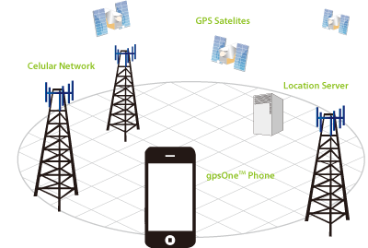
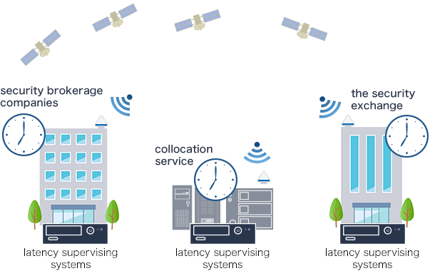

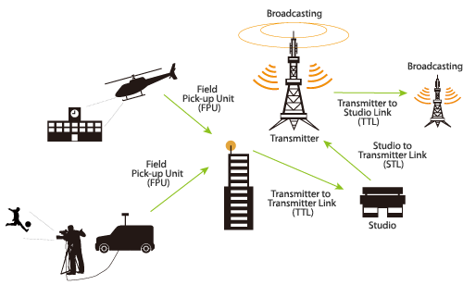
Who needs accurate timing?
Financial transaction
Telecommunication
Broadcasting

Slide 3
ITU-T requirements : accuracy compared with UTC
Technology | Max|TE| | defined by | achieved by
PRTC (Primary Time Clock) | ±100ns compared with UTC | [ITU-T G.8272] | GNSS(single band) + OCXO
PRTC-B | ±40ns compared with UTC | To be published | GNSS(multiband) + OCXO
ePRTC (Enhanced PRTC) | ±30ns compared with UTC | [ITU-T G.8272.1] | GNSS + Cesium
UTC is commonly taken by means of GNSS receiver
Stability
Preventive solution is important against GNSS vulnerability

Slide 4
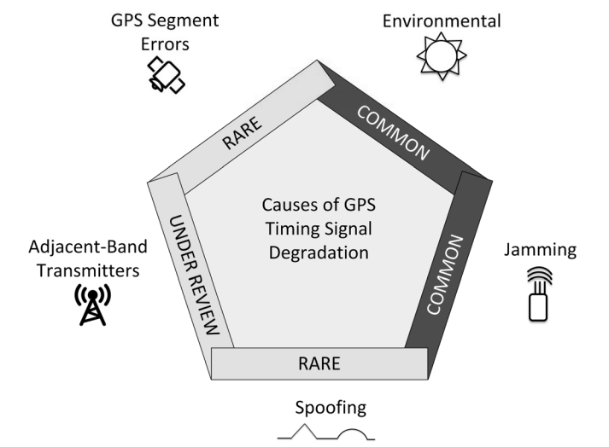
Thread for the GNSS receiver
solutions
GPS Segment
Errors
Multipath
GPS Segment
Errors
Ionosphere
Lightning
Ionosphere
・multi constellation
・multi band
Adjacent-band
Transmitters
Lightning
Adjacent-band
Transmitters
Jamming
Jamming
・holdover
・multi band
・alternative time source
Spoofing
Multipath
Spoofing
・no solution established yet
⇒scope of discussion
出展：https://access.atis.org/apps/group_public/download.php/36304/ATIS-0900005.pdf

Slide 5
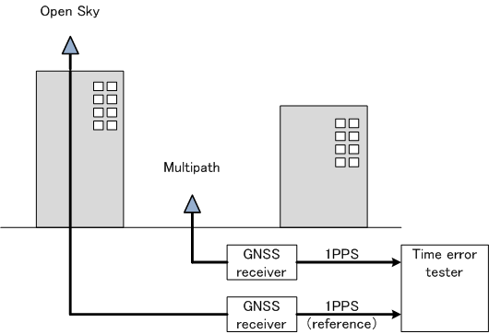
Problems with multipath
Multipath
Multipath
Multipath is
non quantifiable
Accurate UTS must be obtained but it’s difficult accurate UTC in the actual fields
⇒no attention was paid until now
⇒To guarantee 100ns
GNSS vendors force ”open sky”
⇒”good C/N0 and good DOP” does
not guarantee <100ns satisfied
⇒ Multipath quantification was studied with a multipath simulator

Slide 6
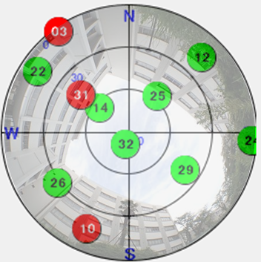
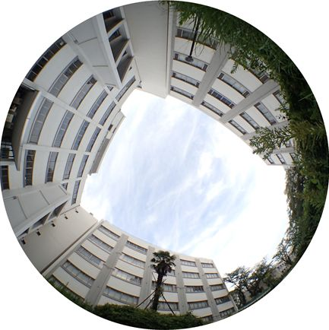
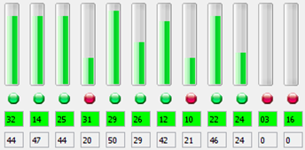
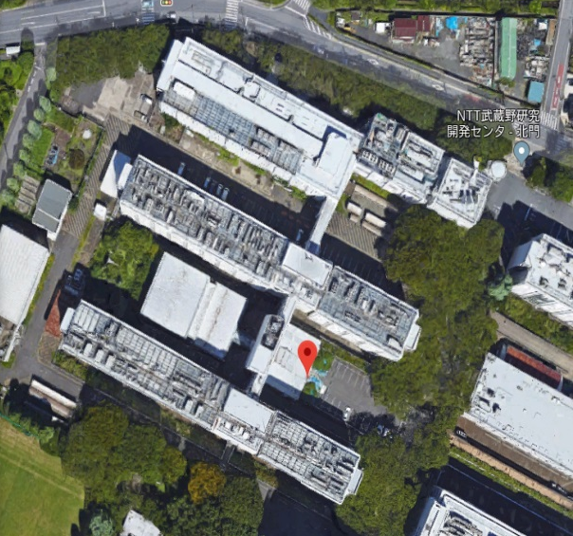


Actual thread of multipath
Multipath
What is the actual Time Error when an antenna is placed here?
N
PRN
C/N0
W
✓ Good C/N0
✓ Good DOP
S
So,
Sky image
Max|TE| < 100ns
＠NTT R&D
(Musashino, Tokyo)
This is WRONG

Slide 7
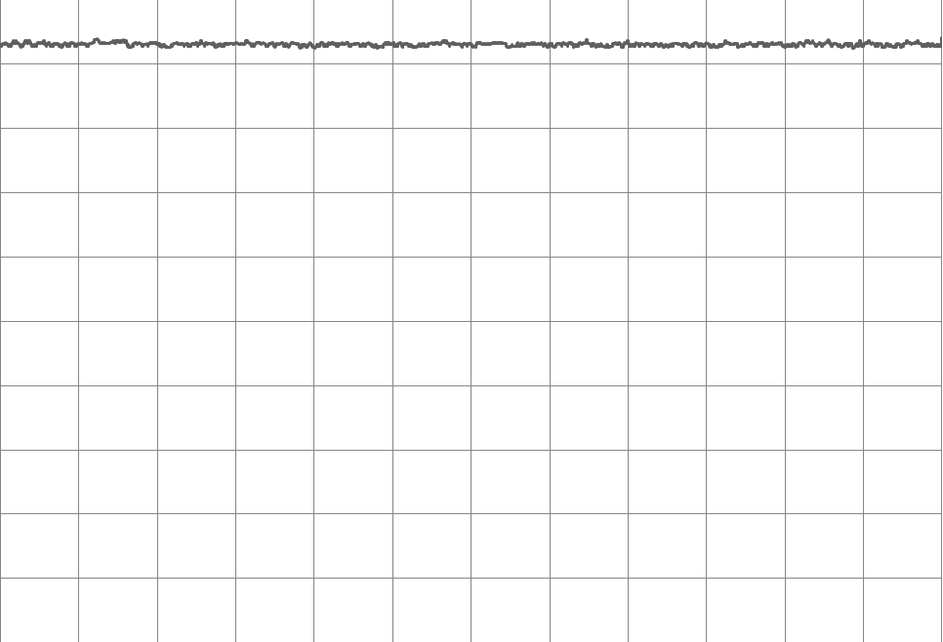
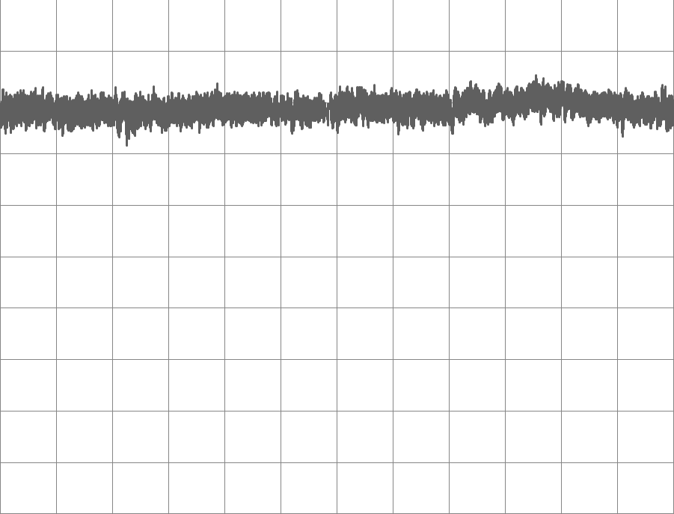
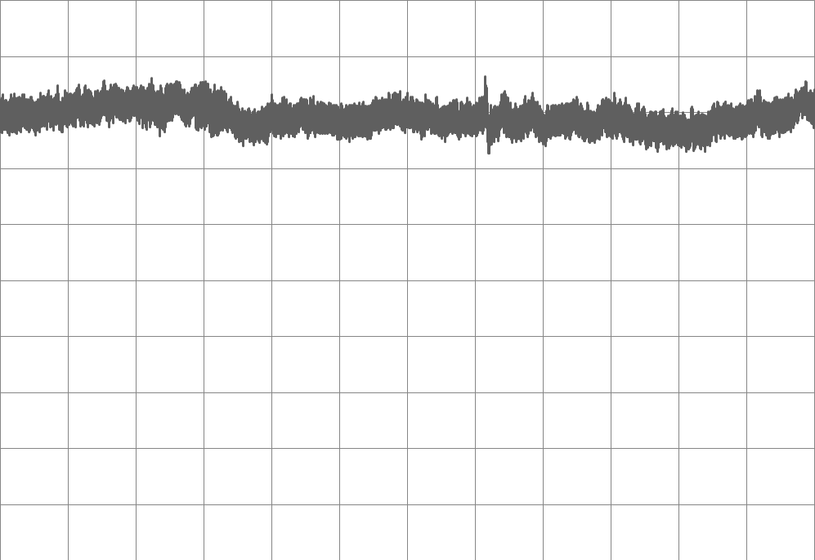
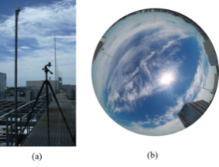
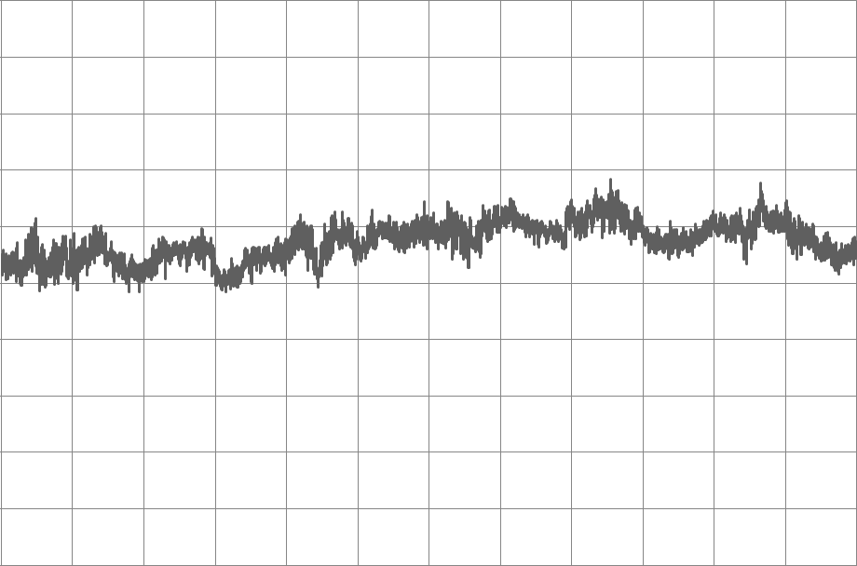
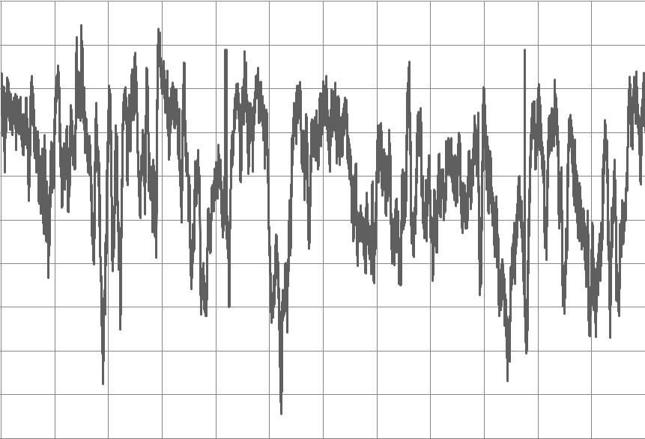
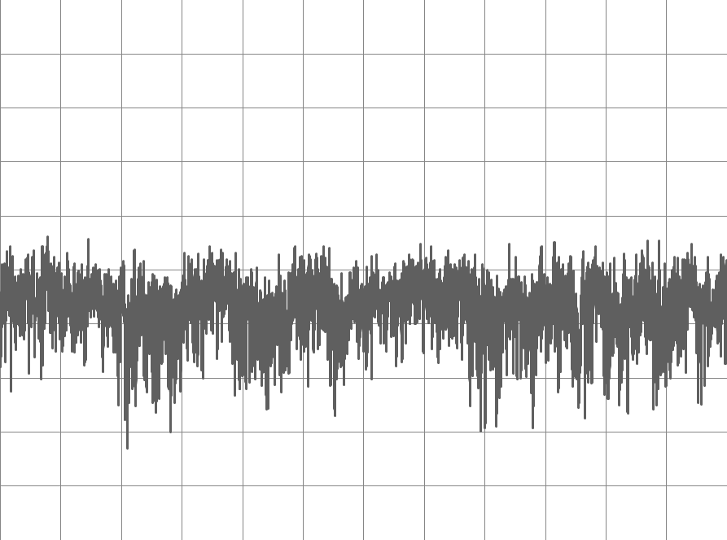
Live test result of multipath
Multipath
Furuno GF-87
GNSS Vendor B
GNSS Vendor C
50
50
50
Open Sky
0
0
0
-50
-50
-50
-100
-100
-100
-150
-150
-150
Time Error(ns)
-200
-200
-200
-250
Max|TE| = 21 ns
-250
-250
-300
-300
Max|TE| = 92 ns
-300
Max|TE| = 86 ns
-350
-350
-350
-400
-400
-400
-450
2
4
6
8
10
12
14
16
18
20
22
24
-450
2
4
6
8
10
12
14
16
18
20
22
24
-450
4
6
8
10
12
14
0
0
0
2
16
18
20
22
24
Elapsed Time(h)
Elapsed Time(h)
Elapsed Time(h)
50
50
50
Multipath
0
0
0
-50
-50
-50
-100
-100
-100
-150
-150
-150
-200
-200
-200
Time Error(ns)
-250
Max|TE| = 208 ns
-250
Max|TE| = 422 ns
-250
-300
-300
-300
Max|TE| = 365 ns
-350
-350
-350
-400
-400
-400
-450
2
4
6
8
10
12
14
16
18
20
22
24
-450
2
4
6
8
10
12
14
16
18
20
22
24
-450
4
6
8
10
12
14
0
0
0
2
16
18
20
22
24
Elapsed Time(h)
Elapsed Time(h)
Elapsed Time(h)
“Max|TE| > 100ns” was measured by every GNSS vendor
⇒ No vendor can satisfy PRTC requirement in actual fields.

Slide 8
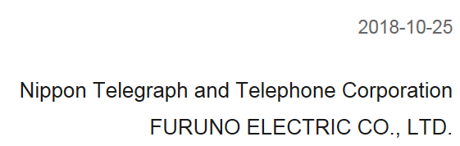
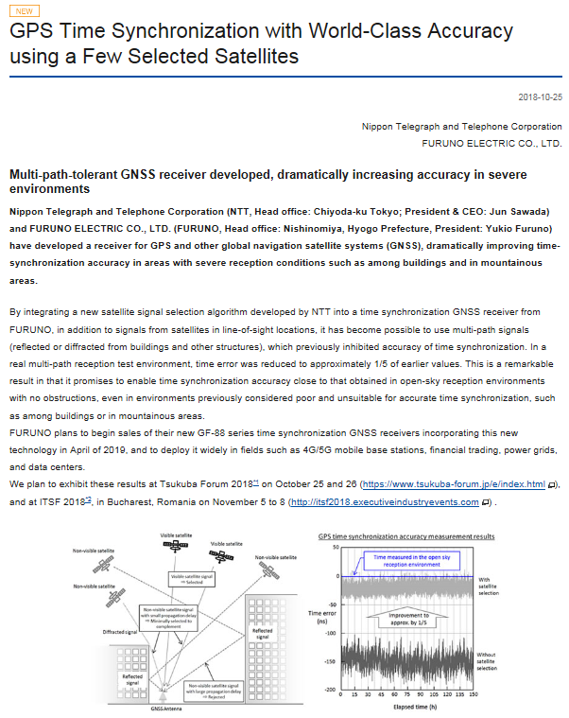
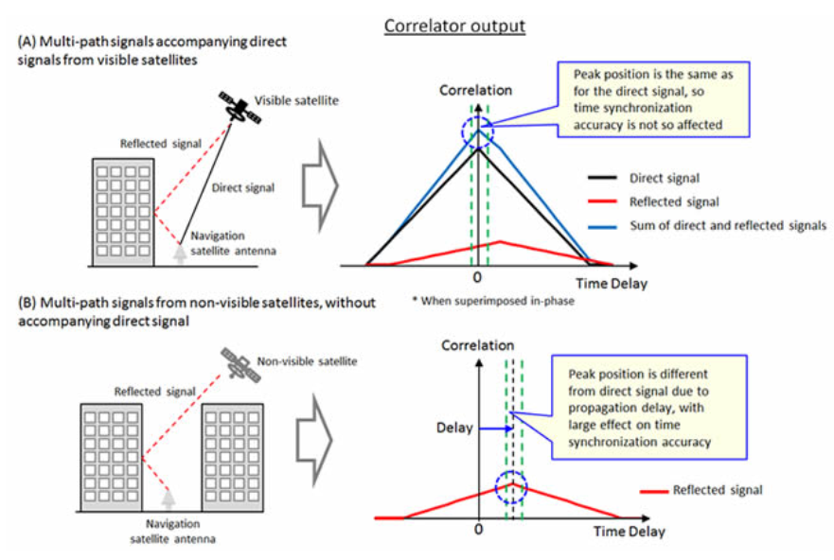
Multipath mitigation algorithm
Multipath
Statistical Satellite selection algorithm
preventsTime Error from deterioration
caused by multipath

Slide 9
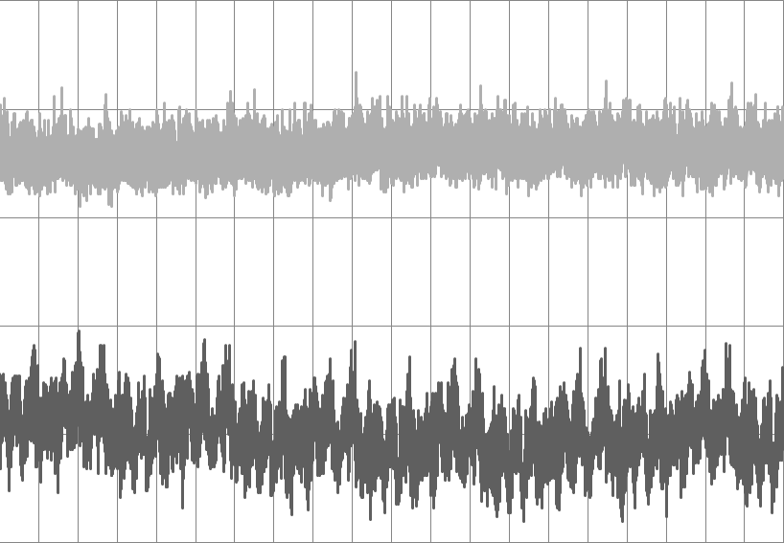
Multipath mitigation algorithm
Multipath
50
0
Algorithm
ON
-50
1/5
Time Error (ns)
-100
Algorithm
OFF
-150
-200
0
15
30
45
60
75
90
105
120
135
150
Time(h)

Slide 10
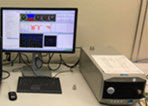

Multipath mitigation algorithm
Multipath
【remaining issue】
R&D site UTC reference available
Actual site UTC reference not available
Antenna location cannot be judged if it satisfies PRTC of 100ns or not
【solution】
Utilizing multipath simulation
In September 2018 Spirent and Furuno
did verification test at NTT site in Tokyo.

Slide 11
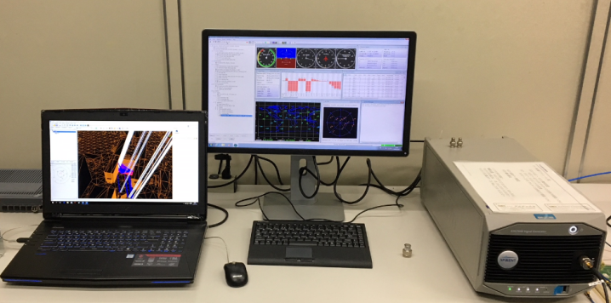
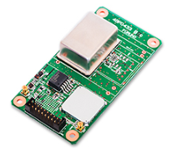
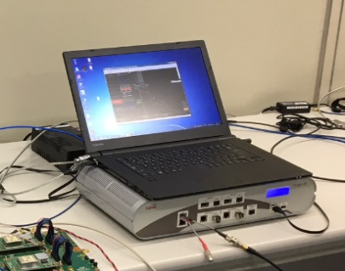
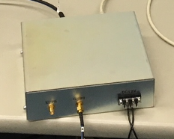
verification test of multipath simulation
Multipath
System diagram
External Reference Clock
GPS Antenna
Coaxial
cable
Spirent
GSS7000
Sim3D +
3D Map
Furuno
GF-8705
（GNSS DO)
10MHz ref
Ethernet
Clear Open-sky
reception environment
1PPS ref
GPS
10MHz ref
Paragon-X
1PPS
DUT
GNSS Receiver
TE

Slide 12
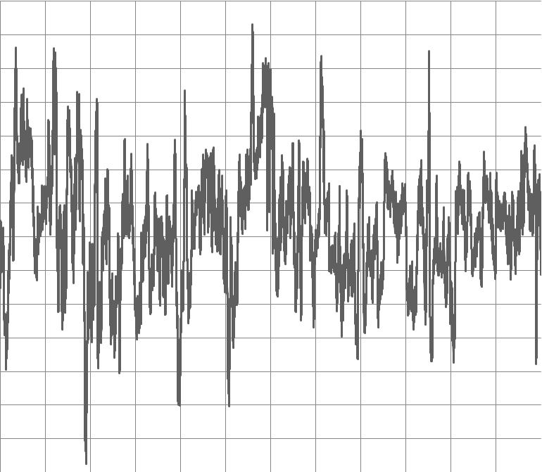
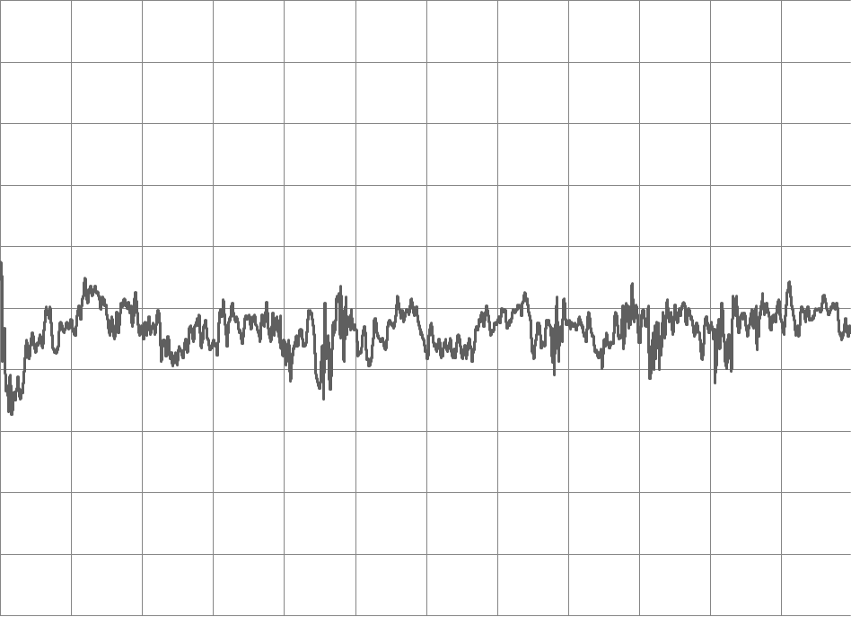
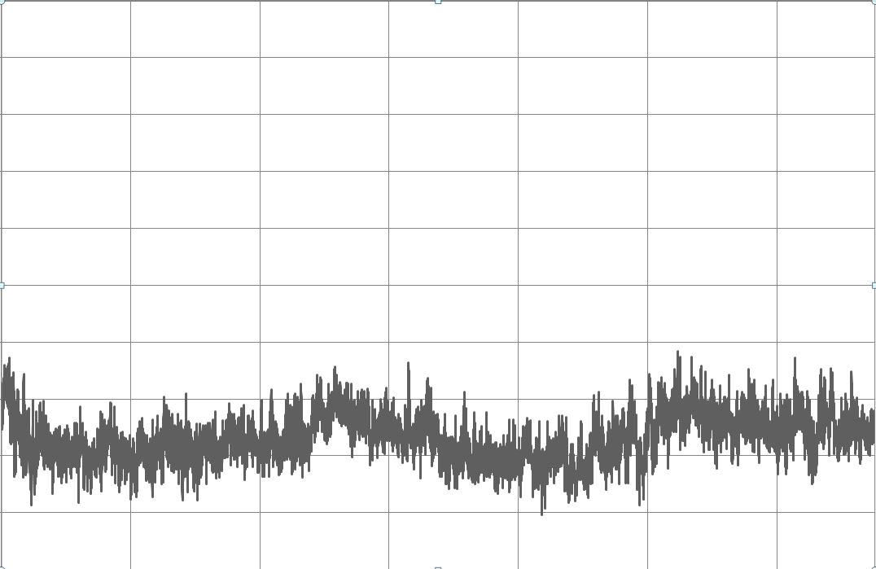
verification test of multipath simulation
Multipath
Furuno GF-87
ublox M8T
Vendor C
Vendor B
Trimble Res SMT 360
50
50
50
Live signal
（Multipath)
0
0
0
-50
-50
-50
-100
-100
-100
-150
-150
-150
Time Error(ns)
-200
-200
-200
-250
-250
-250
-300
-300
-300
-350
-350
-350
-400
-400
-400
-450
2
4
6
8
10
12
14
16
18
20
22
24
-450
2
4
6
8
10
12
14
16
18
20
22
24
-450
14
0
0
0
2
4
6
8
10
12
16
18
20
22
24
Elapsed Time(h)
Elapsed Time(h)
Elapsed Time(h)
Simulated
Multipath
100
50
50
50
0
0
0
-50
-50
-50
-100
-100
-100
-150
-150
-150
-200
-200
-200
Time Error(ns)
-250
-250
-250
Spirent
GSS7000
Sim3D
3D Map
-300
-300
-300
-350
-350
-350
-400
-400
-400
-450
2
4
6
8
10
12
14
16
18
20
22
24
-450
-450
0
0
1
2
3
4
5
6
Elapsed Time(h)
-500
Elapsed Time(h)
-550
-600
4
0
2
6
8
10
12
14
16
18
20
22
24
Elapsed Time(h)

Slide 13
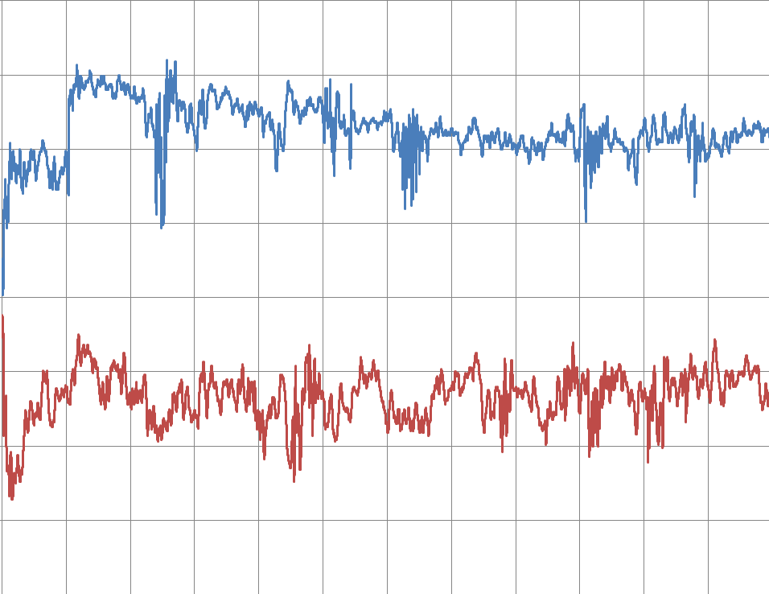
verification test of multipath simulation
Multipath
50
With multipath mitigation
0
Algorithm
ON
-50
-100
-150
1/5
Time Error (ns)
-200
Algorithm
OFF
-250
-300
Without multipath mitigation
-350
0
2
4
6
8
10
12
14
16
18
20
22
24
Elapsed Time (h)

Slide 14

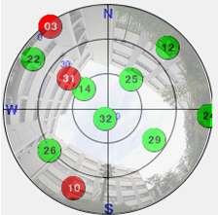
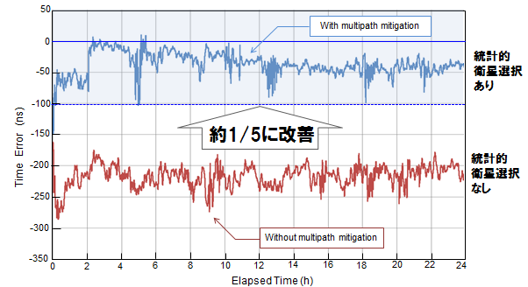
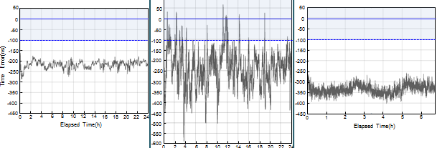
Usefulness of the multipath simulator
Multipath
To better design a GNSS receiver
To select the best suitable GNSS receiver
To select the best suitable antenna location
A or B or C
Multipath reflections can be minimized by utilizing
a multipath simulator.

Slide 15
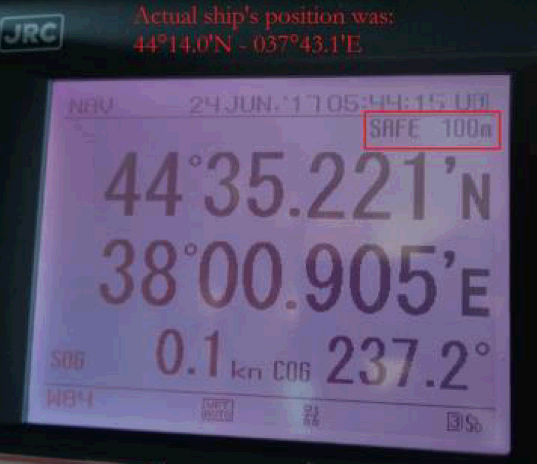
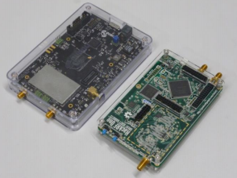
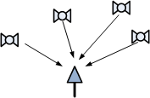

Spoofing対策の概要
Spoofing
Spoofing
example of spoofing attack
at Black Sea in 2017
Spoofing source is becoming easier to get on the market
SDR
Characteristics of spoofing signal
Spoofing source
Normal condition
Spatial solution against spoofing attack is effective.
Furuno suggests an array antenna solution for that.

Slide 16
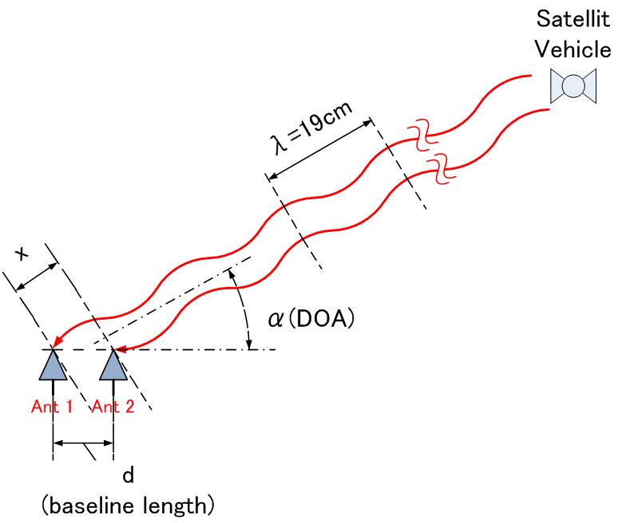

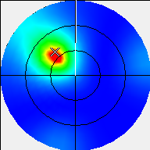
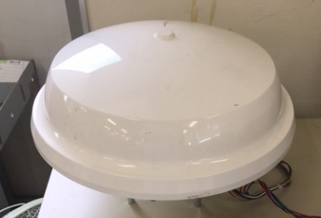

Array antenna to detect spoofing
Spoofing
GNSS SV
SV Orbital position
overlap means not spoofing
N
DOA
(direction of arrive)
spectrum
W
E
90
60
30
0
DOA array antenna
S

Slide 17
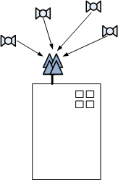
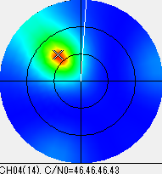
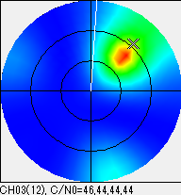
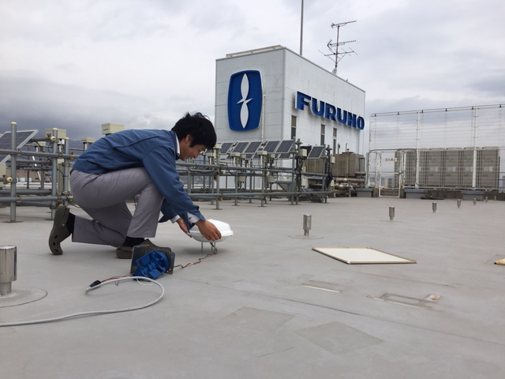
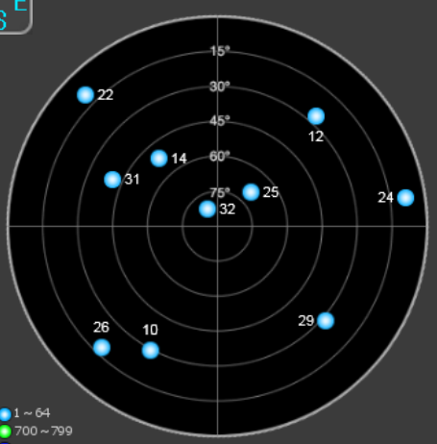
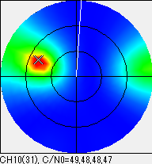
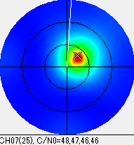
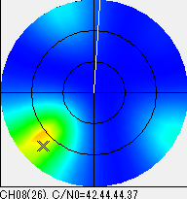
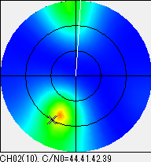
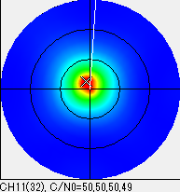
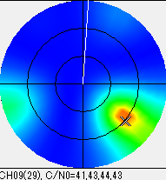
test result
Spoofing
Result of Open sky
Prototype
DOA spectrum and
SV Orbital position are in good agreement.
16

Slide 18
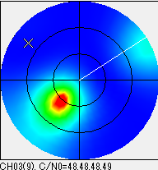








test result
Spoofing
Prototype
Re-radiation antenna
(spoofer is here!)
DOA spectrum of each satellite
shows the same direction.
(not SV Orbital position)
It indicates the location of the spoofer.

Slide 19


QZSS new launching
Spoofing
DOA spectrum of QZSS
QZSS
#194
#195
QZSS (Japan)
Quasi-Zenith Satellite System
Newly launched on 1st November 2018

